Slide 1
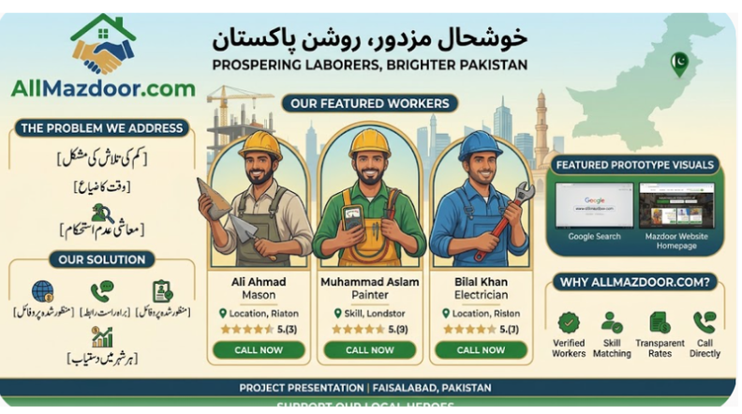

Slide 2
TITLE :ALL MAZDOOR WEBSITE
Problem statement :
Daily-wage workers face job instability due to traditional hiring methods and digital illiteracy, while employers struggle to find verified local labor. AllMazdoor bridge this gap by offering a voice-assisted, CNIC-verified web platform that directly connects skilled workers with local employers.
Objective :
Direct Worker-Employer Connection
Digital Accessibility via Voice Input
CNIC-Based Identity Verification
Fair Wage & Transparent Rating System
Stack holder
Daily –wage laborers
Employee / job providers
Contractor & builders
Platform administrator
Requirements :
Host Server:
Server RAM & CPUStorage:
User Device: Any Mobile / Laptop with Internet & Microphone
2. Software & Tech Stack Requirements
Frontend Languages: HTML5, CSS3, JavaScript
Backend Language: PHP / Python / Node.js
Database Management System: MySQL / MongoDB
Speech Recognition API: Web Speech API / Google Speech-to-Text API
Operating System: Linux (Ubuntu/Debian) Server
Web Server Software: Apache / Nginx
back ground
Daily-wage laborers usually wait at street corners (chowks) every day to find work, which leads to uncertain income and lost time. On the other hand, local homeowners and contractors struggle to find trusted and skilled labor nearby. Common job apps do not help daily-wage workers because many cannot read or write text-based interfaces. AllMazdoor solves this problem by using voice commands, location-based searches, and CNIC verification to easily connect workers with employers.

Slide 3
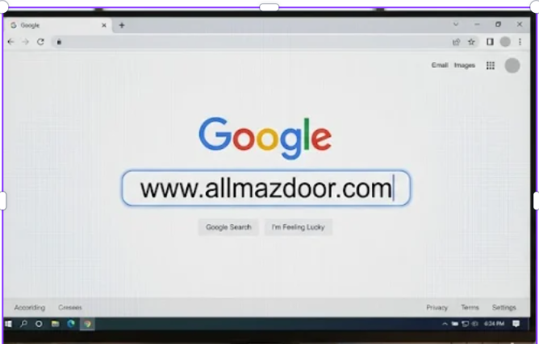

Slide 4
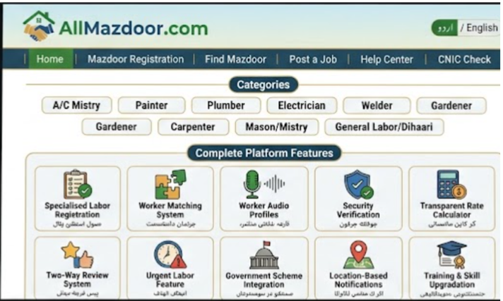

Slide 5
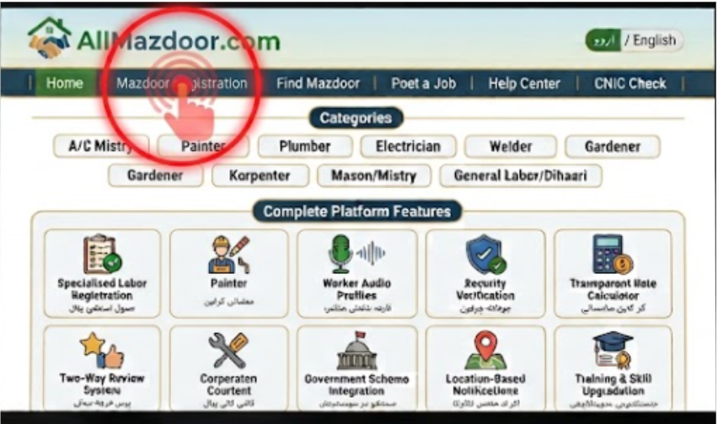

Slide 6
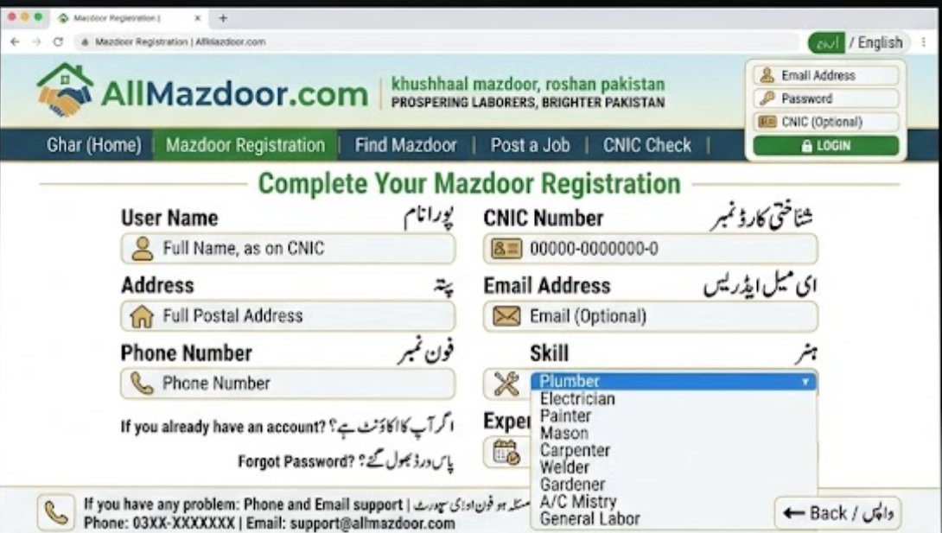

Slide 7
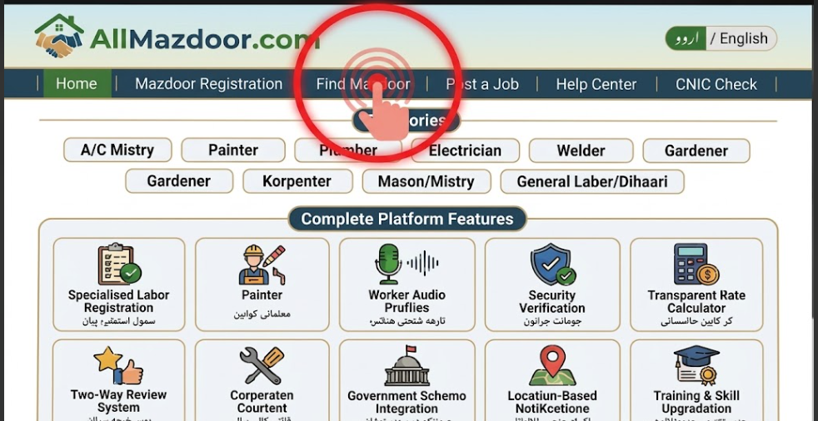

Slide 8
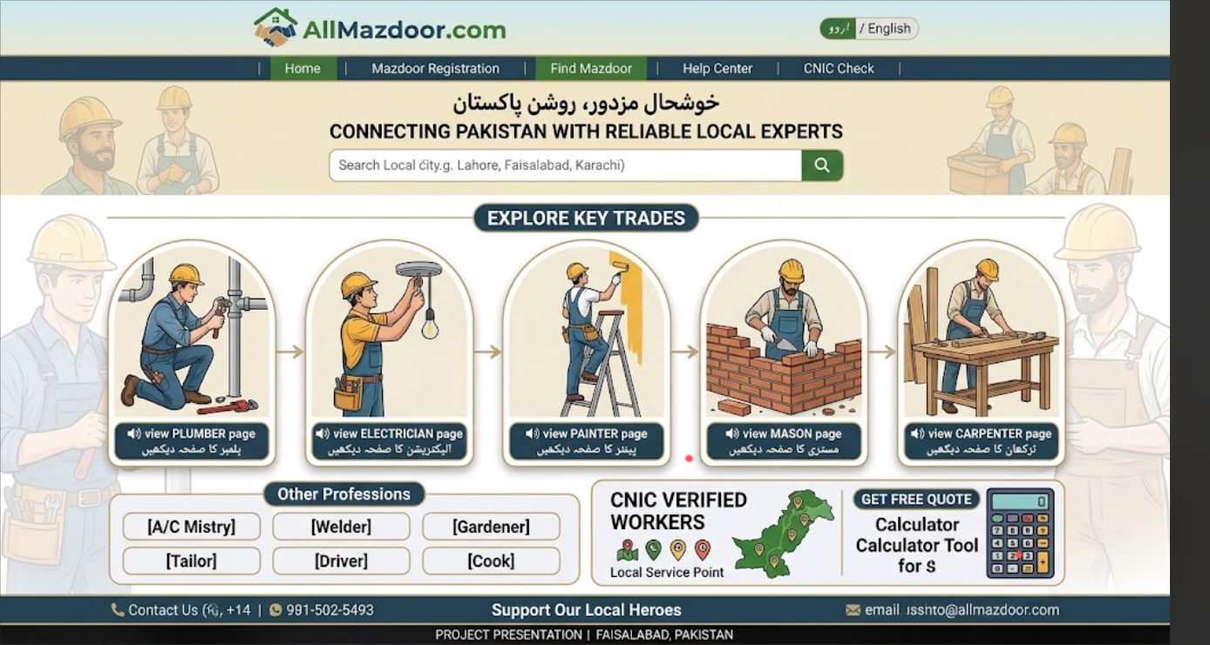

Slide 9
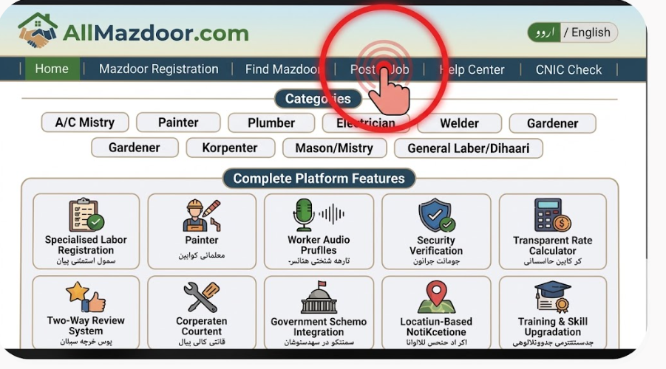

Slide 10
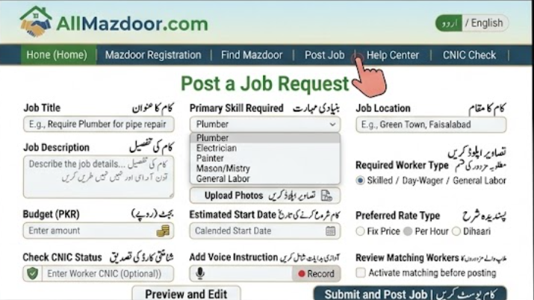

Slide 11
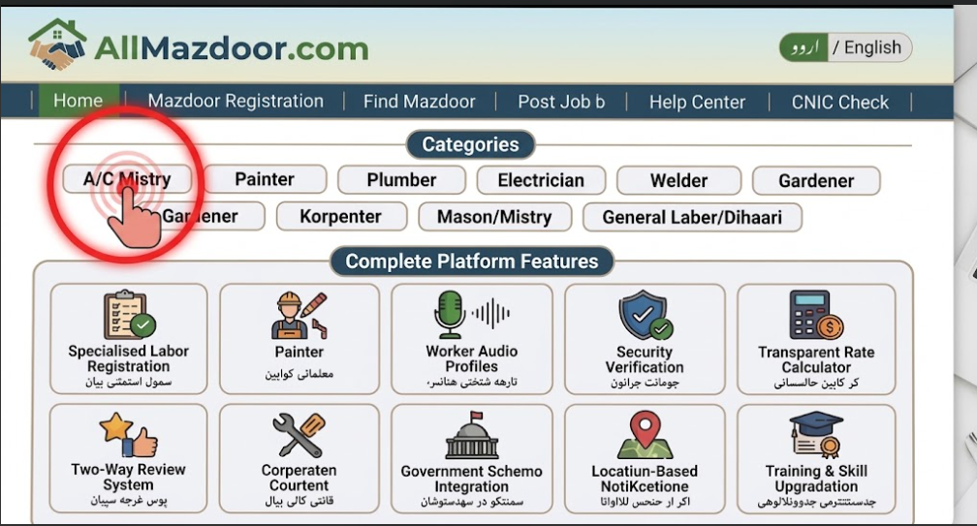

Slide 12
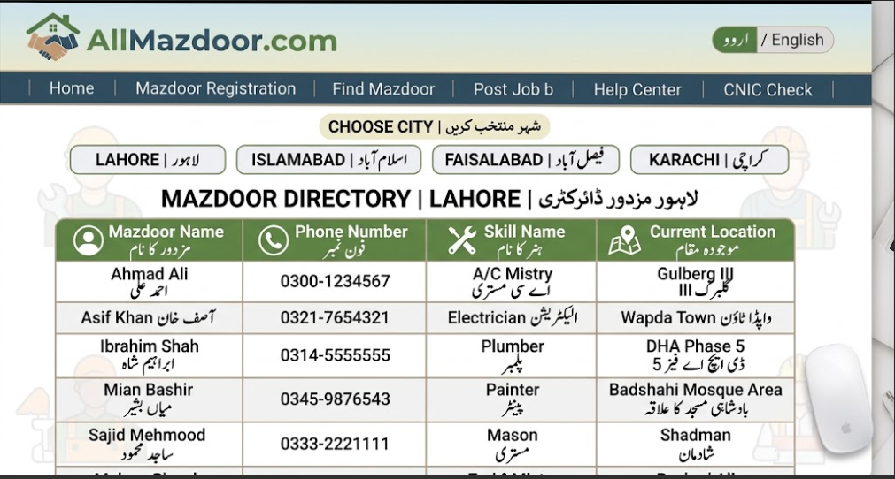

Slide 13
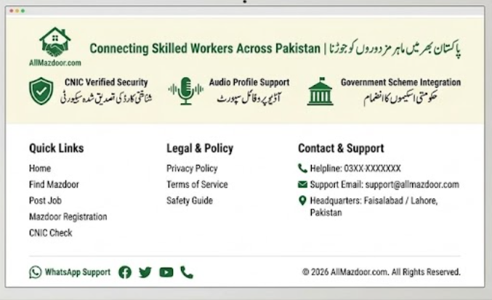

Slide 14
